Slide 1
Presentation-1 on Chosen Advanced ML Technique Advanced Machine Learning ITI41820

Slide 2
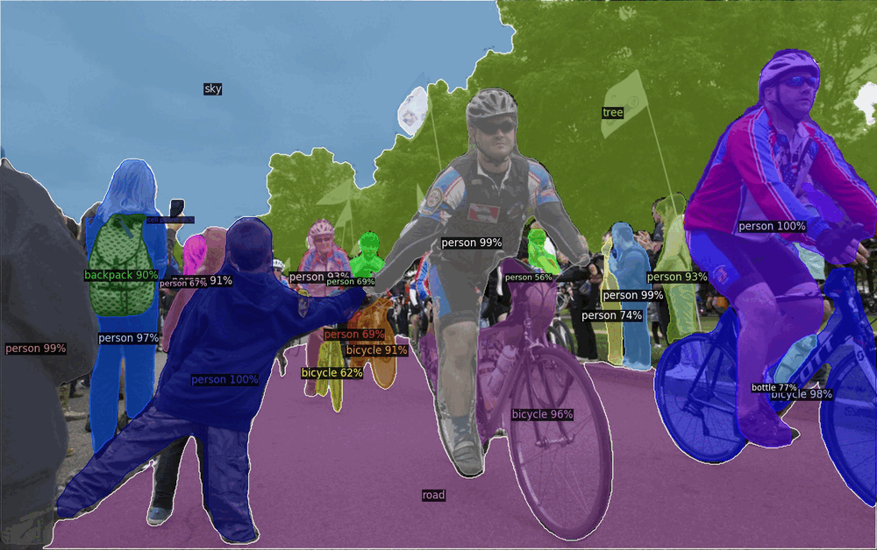
What is Object Detection? Simply put – Classification and Localisation!
For any object detection task
Object Proposals
Classification
Localisation
Source: Facebook/Meta AI

Slide 3
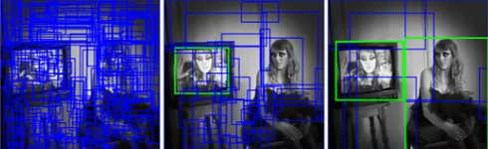

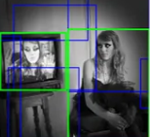
1. What is this technique / algorithm?
Chosen Technique / Algorithm : One-Stage Object Detection using EfficientDet algorithm.
TSOD
TSOD | OSOD
RCNN | YOLO
Fast RCNN | SSD
Faster RCNN | EfficientDet
OSOD

Slide 4
2. Why EfficientDet special?
Cost effective (Less parameters than other OSOD)
Novel compuound scaling (will see more detail in next slides)
Novel Bi-FPN Network (will see more detail in next slides)
Balances the speed vs accuracy tradeoff
Adaptive Transfer Learning

Slide 5
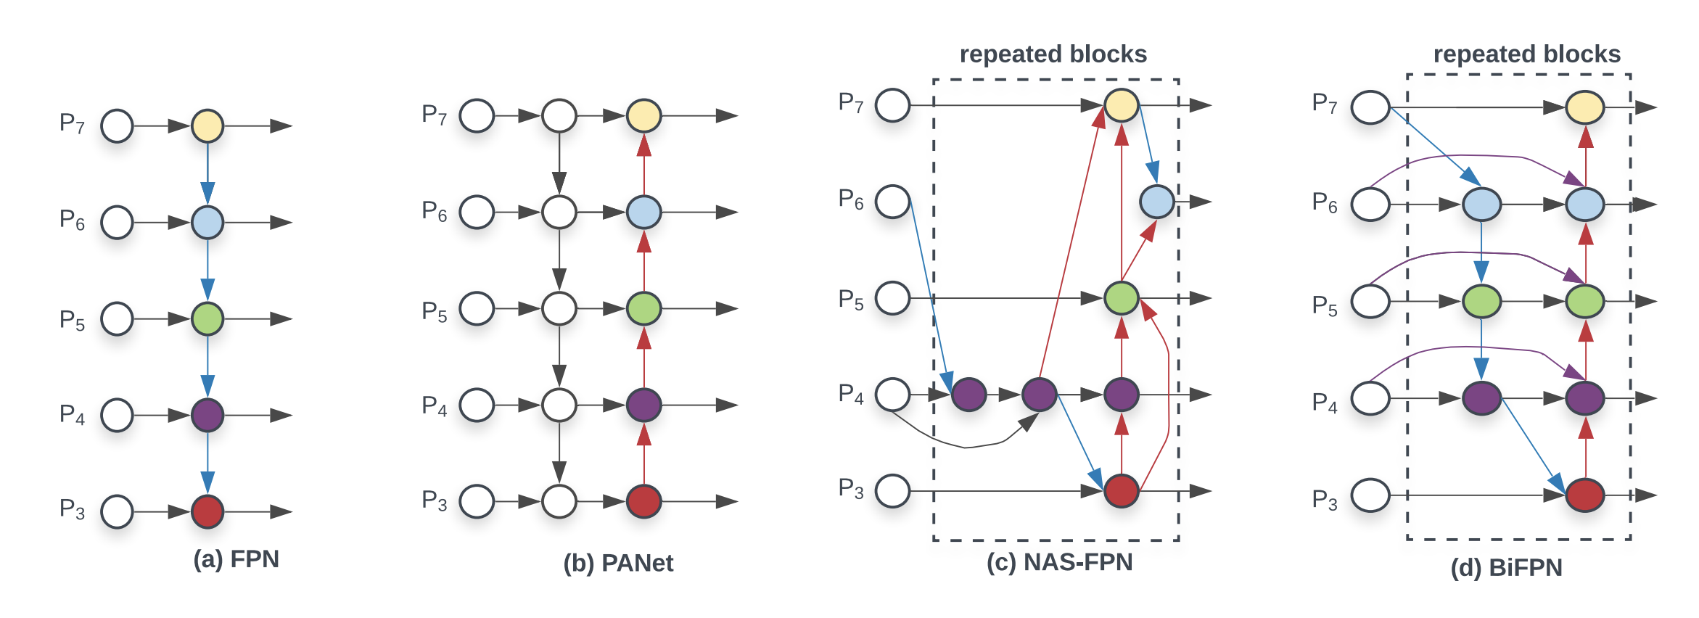
3.1 How is it different from other similar techniques
BiFPN - Bilateral Fusion Pyramid Network
Tan, M., Pang, R., & Le, Q. V. (2020). Efficientdet: Scalable and efficient object detection. In Proceedings of the IEEE/CVF conference on computer vision and pattern recognition (pp. 10781-10790).
Used in EfficientDet
Used in YOLOv5
Used in SSD

Slide 6
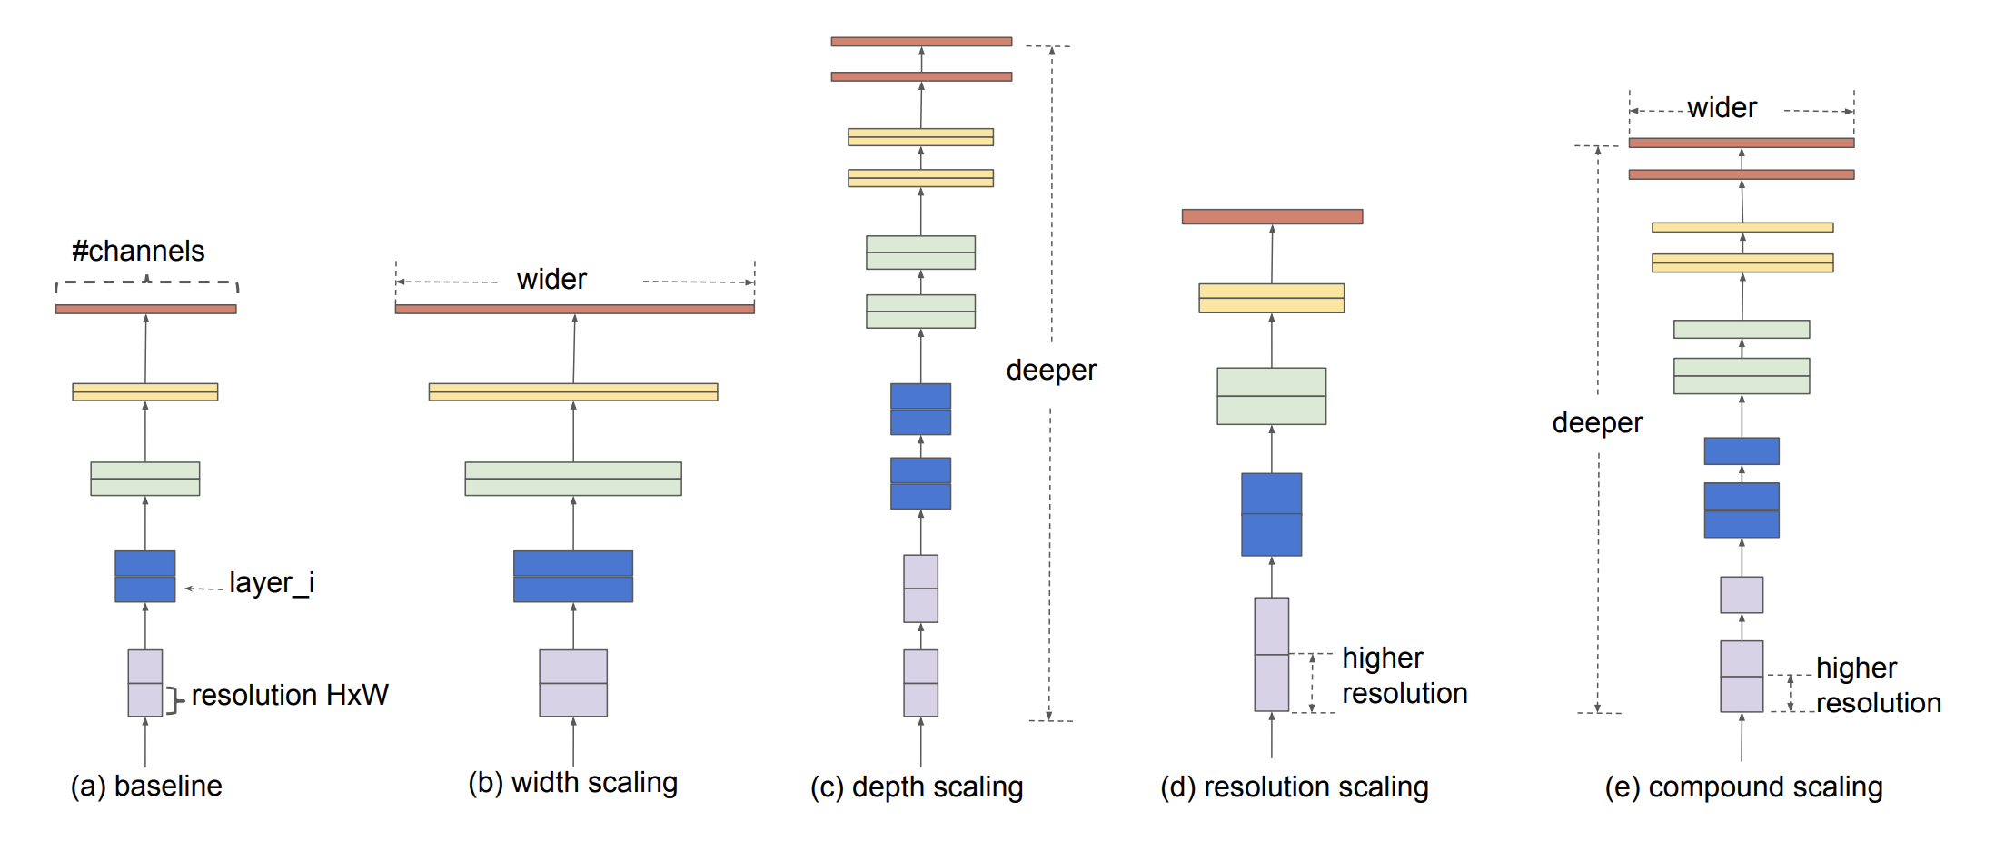
3.2 How is it different from other similar techniques
Compound Scaling method for Uniform Scaling
Tan, M., & Le, Q. (2019, May). Efficientnet: Rethinking model scaling for convolutional neural networks. In International conference on machine learning (pp. 6105-6114). PMLR.
+
=

Slide 7
3.3 Practical Example
Widely used in real time edge computing with high time constraints
EfficientDet for fabric defect detection based on edge computing (2021, S. Song et al)
EfficientDet for Crop Circle Detection in Desert (M.L.Mekhalfi et al 2022)
Drivers Fatigue Detection using EfficientDet (R. Ayachi et al 2021)
Automatic Helmet Detection (M.T. Ubaid 2021)

Slide 8
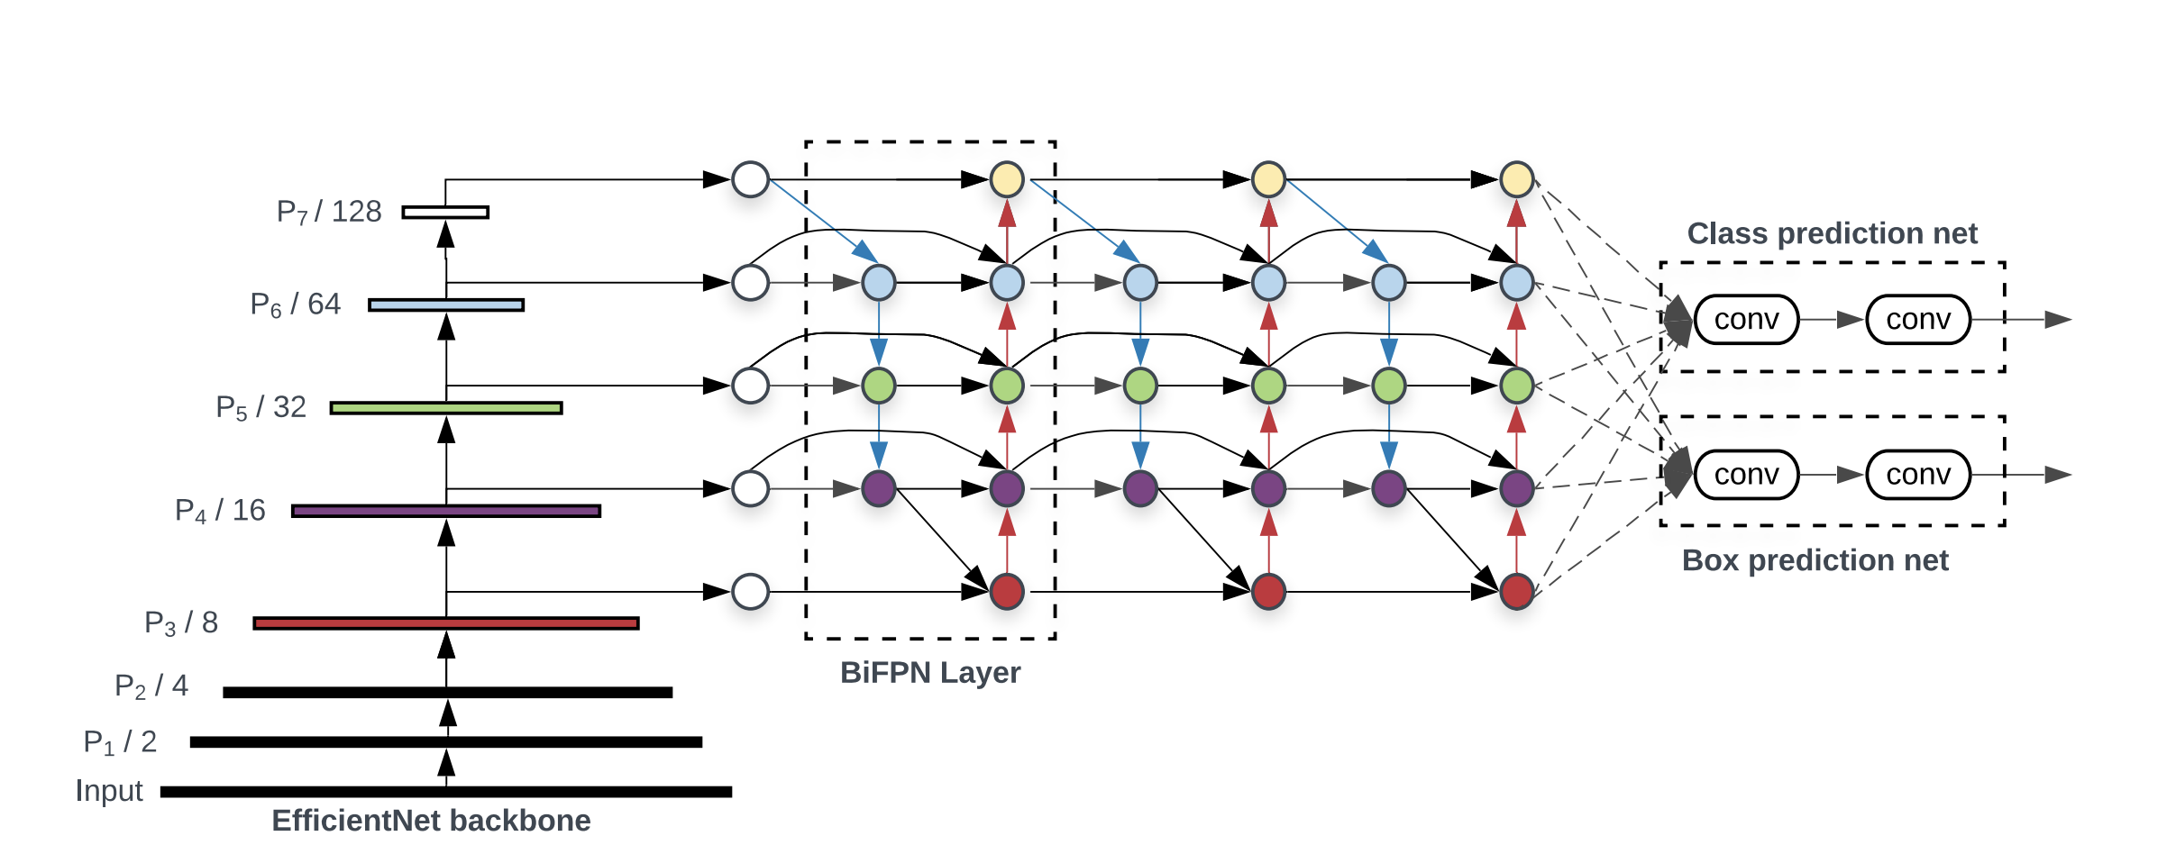
4.1 Working Principle
EfficientDet Architecture
Tan, M., Pang, R., & Le, Q. V. (2020). Efficientdet: Scalable and efficient object detection. In Proceedings of the IEEE/CVF conference on computer vision and pattern recognition (pp. 10781-10790).
Backbone
Head
Neck

Slide 9
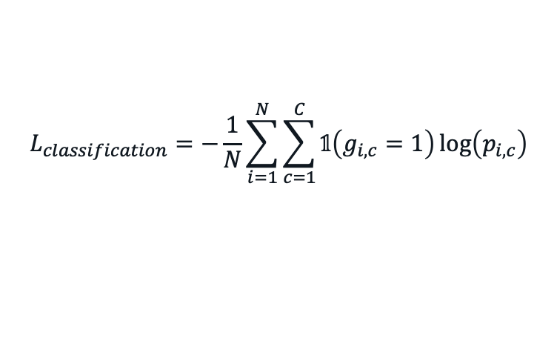
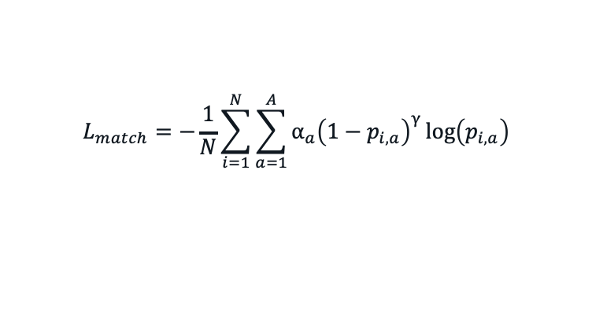
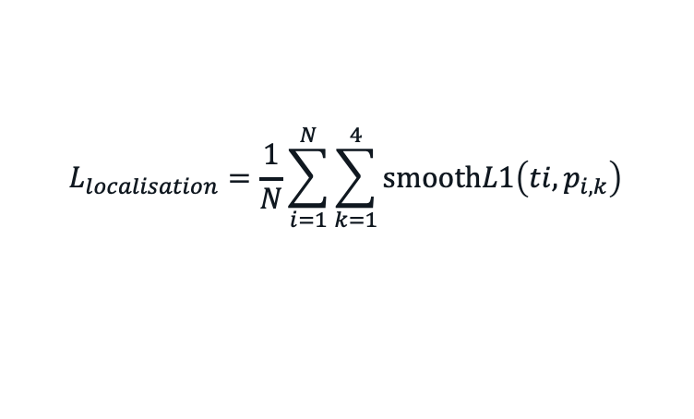
4.2 Working Principle
Loss Functions
Classification Loss
Localisation Loss
Anchor Matching Loss
$$L_{classification}=−\frac{1}{N}\sum_{i=1}^{N}{\sum_{c=1}^{C}{𝟙\left(g_{i,c}=1\right)\log\left(p_{i,c}\right)}}$$
$$L_{localisation}=\frac{1}{N}\sum_{i=1}^{N}{\sum_{k=1}^{4}{\text{smooth}L1\left(ti,p_{i,k}\right)}}$$
$$L_{match}=−\frac{1}{N}\sum_{i=1}^{N}{\sum_{a=1}^{A}{α_{a}{\left(1−p_{i,a}\right)}^{γ}}\log\left(p_{i,a}\right)}$$

Slide 10
5. Advantages and Disadvantages
Advanatages
Super efficient and Accurate among other OSOD
Less number of parameters compared to other OSOD
Simple Architecture
Disadvantages
Large memory requirement
Train time
Lack of Interpretability

Slide 11
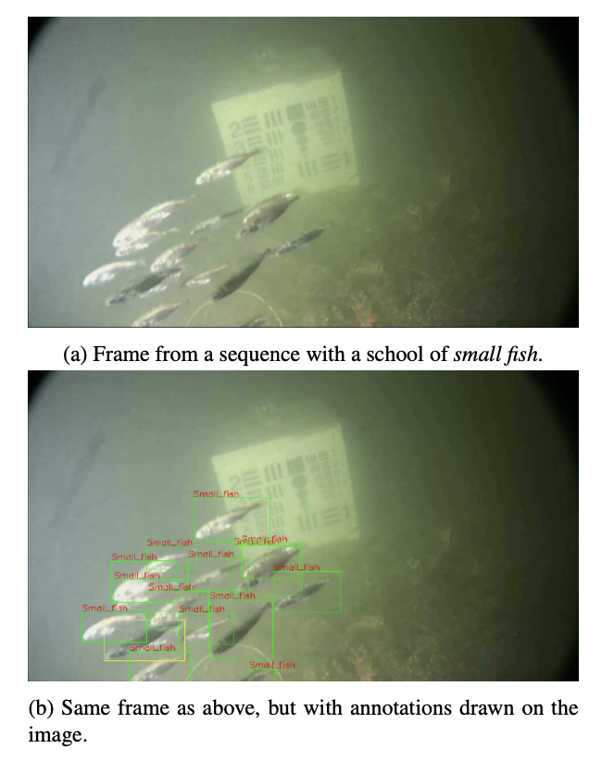
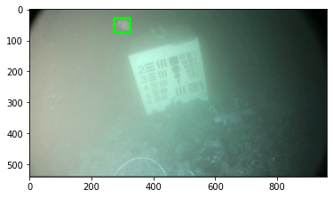
6.1 Probable Practical Application
Detection of underwater martime objects (Brackish Dataset AALBORG University) – Cross Domain Modalities
Source of Dataset: Pedersen, M., Bruslund Haurum, J., Gade, R., & Moeslund, T. B. (2019). Detection of marine animals in a new underwater dataset with varying visibility. In Proceedings of the IEEE/CVF Conference on Computer Vision and Pattern Recognition Workshops (pp. 18-26).

Slide 12
6.2 Why EfficientDet for this application than other OSOD like YOLO, SSD, RetinaNet
EfficientDet has reportedly proven to work best on
Complex task domains where objects are relatively difficult to identify because of the nature of task.
For example – Crop Detection, Adulteration detection in grains, Defect detection in fabric factory, Efficient site detection for solar power etc.
Most of the researchers has considered YOLO framework because of its fast-to-implement, however, for such complex tasks, EfficientDet is expected to give SOTA accuracy on such tasks. One of such tasks, that I plan to chose is “Detection of underwater martime objects”

Slide 13
Planned Novel Contributions
EfficientDet has less interpretability.
To make it more Interpretable.
Make it robust for adversarial attacks, by adversarial training.

Slide 14

Thank You! Questions? References:
Michigan Online
Tan, M., Pang, R., & Le, Q. V. (2020). Efficientdet: Scalable and efficient object detection. In Proceedings of the IEEE/CVF conference on computer vision and pattern recognition (pp. 10781-10790).

